Slide 1
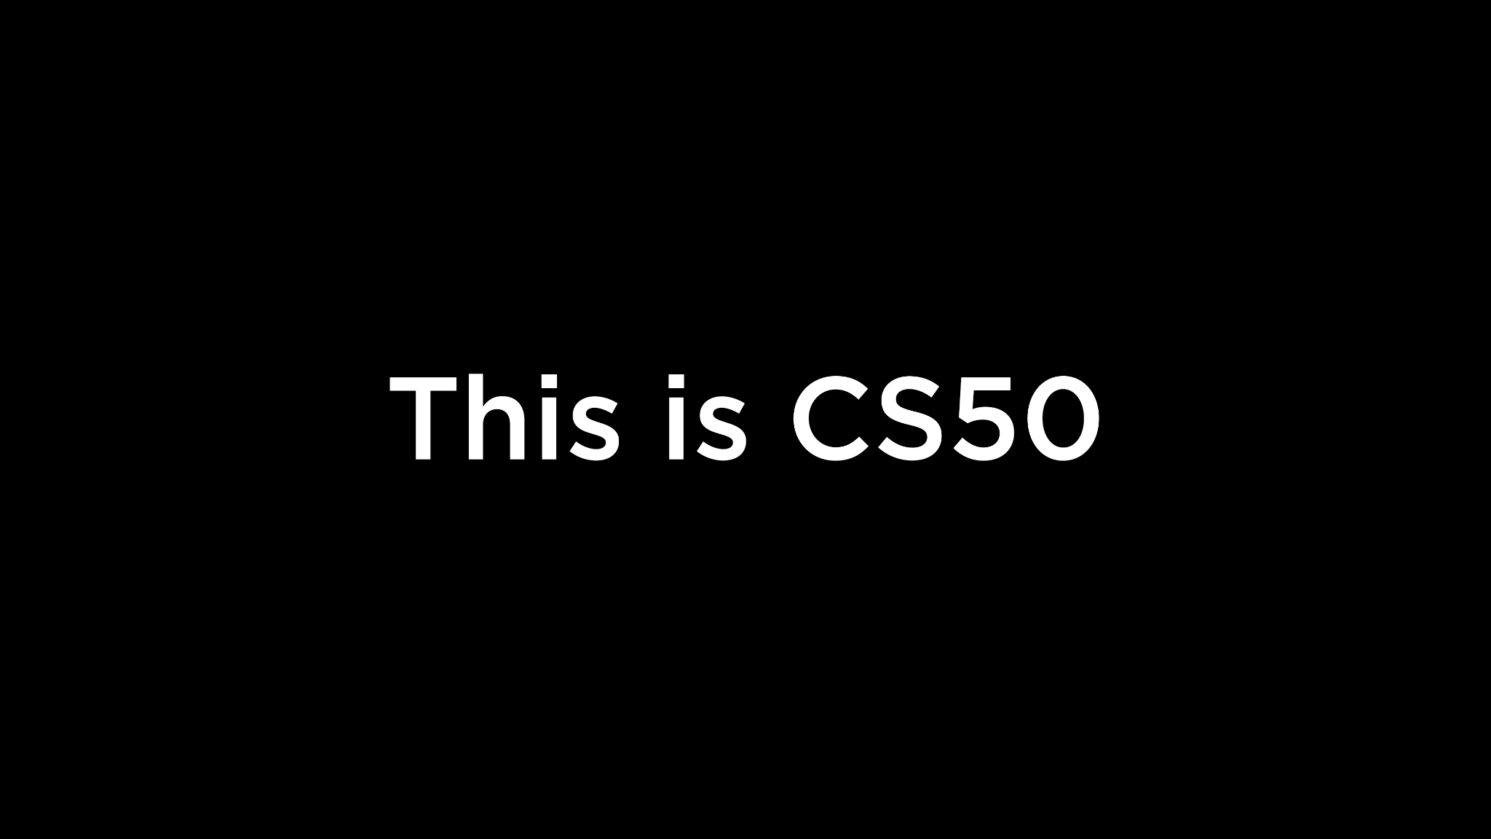
Notes:
Reload codespace
Uncheck VS Code tabs

Slide 2
This is CS50
Visit cs50.dev if you'd like to try writing some code during class, but no need to!
We'll take a break partway through class, with muffins for snacks! 🫐
Looking for a study buddy? Submit cs50.ly/studybuddy.
Like to attend the first CS50 Lunch this Fri 9/12 at 1:15pm? RSVP at cs50.ly/lunch!
Do say hi or ask questions during break or after class!
What do today's binary bulbs spell?
And congratulations to CS50 Puzzle Day's winners!
🥇 bzzt, i clue plum, Annie Guo, Marvin Mao, Rachel Gao, Kaylee Ji 🥈 Grad Unified Theory, Nicholas Sbalbi, Gautam Prabhu, Alex Stoneman, John Bell 🥉 The 8.5th Shard, Max Neal, Joy An, Trinity Dysis, Adeline Wong 🍀 Manasvi Goyal, Emily Jia, Achraf Zemzami, Nabiha Vahora
Notes:
https://www.youtube.com/watch?v=7qirrV8w5SQ

Slide 4
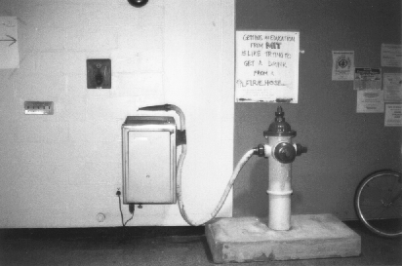
Notes:
http://hacks.mit.edu/Hacks/by_year/1991/fire_hydrant/

Slide 5
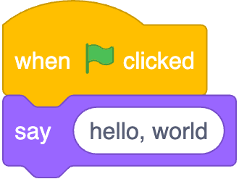
Notes:
https://scratchblocks.github.io/#?style=scratch3&script=when%20green%20flag%20clicked%0Asay%20%5Bhello%2C%20world%5D

Slide 6
#include <stdio.h>
int main(void) {
printf("hello, world\n");
}

Slide 7
#include <stdio.h>
int main(void) {
printf("hello, world\n");
}

Slide 8
source code

Slide 9
01111111 01000101 01001100 01000110 00000010 00000001 00000001 00000000 00000000 00000000 00000000 00000000 00000000 00000000 00000000 00000000 00000010 00000000 00111110 00000000 00000001 00000000 00000000 00000000 10110000 00000101 01000000 00000000 00000000 00000000 00000000 00000000 01000000 00000000 00000000 00000000 00000000 00000000 00000000 00000000 11010000 00010011 00000000 00000000 00000000 00000000 00000000 00000000 00000000 00000000 00000000 00000000 01000000 00000000 00111000 00000000 00001001 00000000 01000000 00000000 00100100 00000000 00100001 00000000 00000110 00000000 00000000 00000000 00000101 00000000 00000000 00000000 01000000 00000000 00000000 00000000 00000000 00000000 00000000 00000000 01000000 00000000 01000000 00000000 00000000 00000000 00000000 00000000 01000000 00000000 01000000 00000000 00000000 00000000 00000000 00000000 11111000 00000001 00000000 00000000 00000000 00000000 00000000 00000000 11111000 00000001 00000000 00000000 00000000 00000000 00000000 00000000 00001000 00000000 00000000 00000000 00000000 00000000 00000000 00000000 00000011 00000000 00000000 00000000 00000100 00000000 00000000 00000000 00111000 00000010 00000000 00000000 00000000 00000000 00000000 00000000 ...

Slide 10
machine code

Slide 11
input →
→ output
Notes:
starting today, no green flag

Slide 13
source code →

Slide 14
source code →
→ machine code

Slide 15
compiler
source code →
→ machine code

Slide 16
Visual Studio Code for CS50
cs50.dev
Notes:
where to write, compile code

Slide 17
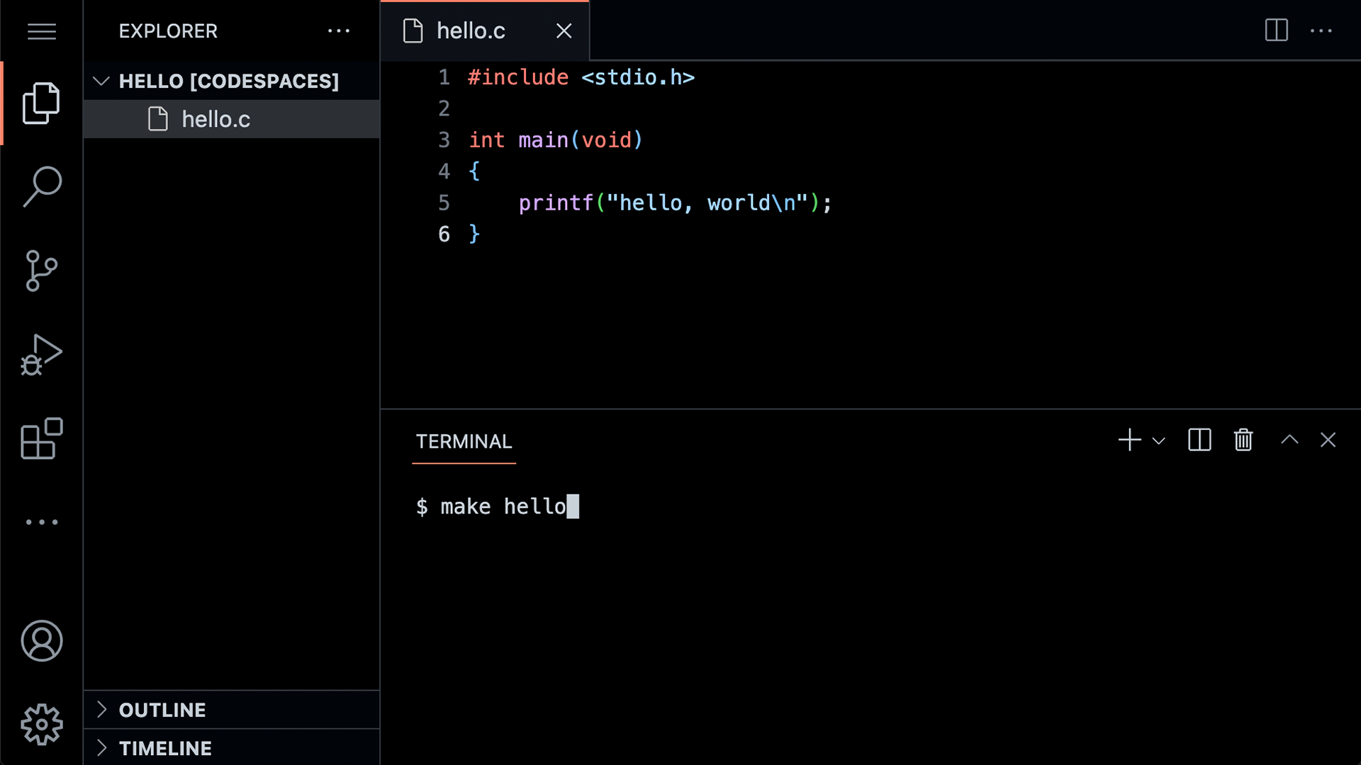

Slide 23
graphical user interface

Slide 24
GUI

Slide 26
command-line interface

Slide 27
CLI

Slide 29
#include <stdio.h>
int main(void) {
printf("hello, world\n");
}
Notes:
hello0.c

Slide 30
code hello.c
make hello
./hello

Slide 31
Notes:
https://scratchblocks.github.io/#?style=scratch3&script=when%20green%20flag%20clicked%0Asay%20%5Bhello%2C%20world%5D

Slide 32
#include <stdio.h>
int main(void) {
printf("hello, world\n");
}

Slide 33
#include <stdio.h>
int main(void) {
printf("hello, world\n");
}

Slide 34

printf("hello, world\n");

Slide 35
printf("hello, world\n");

Slide 36
printf("hello, world\n");

Slide 37
printf("hello, world\n");

Slide 38
printf("hello, world\n");

Slide 39
printf("hello, world\n");

Slide 40
printf("hello, world\n");
Notes:
lot of ways to make mistakes; try omitting semicolon

Slide 41

Notes:
https://editor.codecogs.com/

Slide 42
input →
→ output

Slide 43
function
arguments →
→ side effects

Slide 44
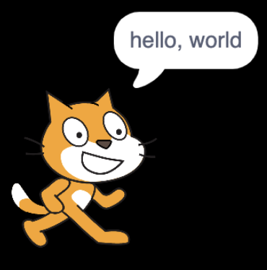


→
→
Notes:
https://scratchblocks.github.io/#?style=scratch3&script=say%20%5B%5D
https://scratchblocks.github.io/#?style=scratch3&script=say%20%5Bhello%2C%20world%5D

Slide 45
escape sequences
Notes:
try omitting \n

Slide 46
\n
\r
\"
\'
\\
…

Slide 47
header files
Notes:
try removing stdio.h

Slide 48
libraries

Slide 49
stdio.h

Slide 50
Manual Pages
manual.cs50.io

Slide 51
manual.cs50.io/#stdio.h
Notes:
open tab in advance

Slide 52
manual.cs50.io/3/printf
Notes:
open tab in advance

Slide 53
cs50.h

Slide 54
manual.cs50.io/#cs50.h
Notes:
open tab in advance

Slide 55
get_char
get_double
get_float
get_int
get_long
get_string
...

Slide 56
get_char
get_double
get_float
get_int
get_long
get_string
...

Slide 57
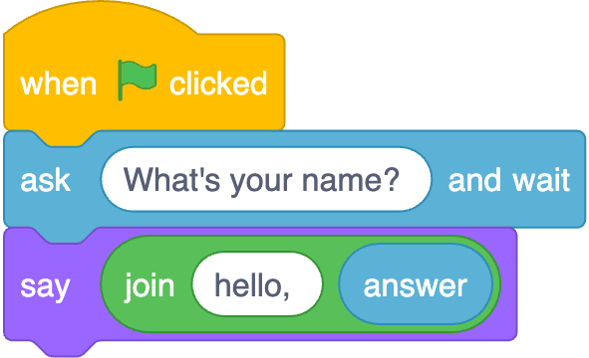
Notes:
https://scratchblocks.github.io/#?style=scratch3&script=when%20green%20flag%20clicked%0Aask%20%5BWhat's%20your%20name%3F%20%5D%20and%20wait%0Asay(join%20%5Bhello%2C%20%5D%20(answer))

Slide 58
input →
→ output
Notes:
starting today, no green flag

Slide 59
function
arguments →
→ return value

Slide 60
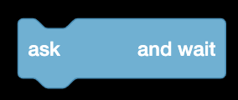


→
→
Notes:
https://scratchblocks.github.io/#?style=scratch3&script=ask%20%5B%5D%20and%20wait
https://scratchblocks.github.io/#?style=scratch3&script=ask%20%5BWhat's%20your%20name%3F%5D%20and%20wait
https://scratchblocks.github.io/#?style=scratch3&script=(answer)

Slide 61
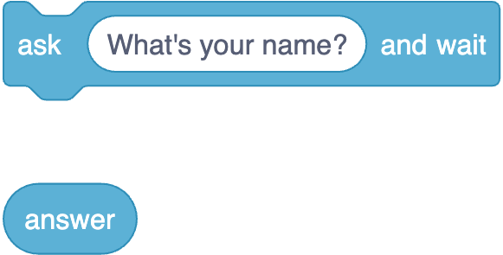
Notes:
https://scratchblocks.github.io/#?style=scratch3&script=ask%20%5BWhat's%20your%20name%3F%5D%20and%20wait%0A(answer)

Slide 62
string answer = get_string( );
printf("hello, %s", answer);

Slide 63
string answer = get_string("What's your name? ");
printf("hello, %s", answer);

Slide 64
string answer = get_string("What's your name? ");
printf("hello, %s", answer);

Slide 65
string answer = get_string("What's your name? ");
printf("hello, %s", answer);

Slide 66
string answer = get_string("What's your name? ");
printf("hello, %s", answer);

Slide 67
string answer = get_string("What's your name? ");
printf("hello, %s", answer);
Notes:
hello1.c

Slide 68
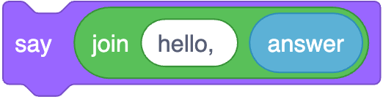
printf("hello, %s", answer);
Notes:
https://scratchblocks.github.io/#?style=scratch3&script=say%20(join%5Bhello%2C%20%5D%20(answer)%0A

Slide 69
printf("hello, %s\n", answer);

Slide 70
printf("hello, %s\n", answer);

Slide 71
printf("hello, %s\n", answer);

Slide 72
printf("hello, %s\n", answer);

Slide 73
printf("hello, %s\n", answer);
Notes:
hello2.c

Slide 74
Linux

Slide 75
cd
cp
ls
mkdir
mv
rm
rmdir
...
Notes:
ls
rm hello
mkdir hello/
mv hello.c hello
cd hello
mv hello.c old.c
mv old.c hello.c
cp hello.c backup.c
rm backup.c
mv hello.c ..
cd
rmdir hello

Slide 76
conditionals

Slide 77
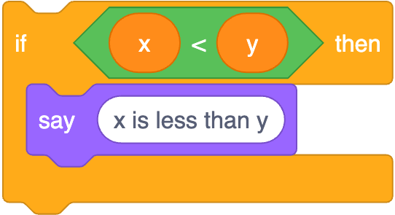
if (x < y) {
printf("x is less than y\n");
}
Notes:
https://scratchblocks.github.io/#?style=scratch3&script=if%20%3C(x)%20%3C%20(y)%3E%20then%0Asay%20%5Bx%20is%20less%20than%20y%5D

Slide 78
if (x < y) {
printf("x is less than y\n");
}

Slide 79
if (x < y) {
printf("x is less than y\n");
}

Slide 80
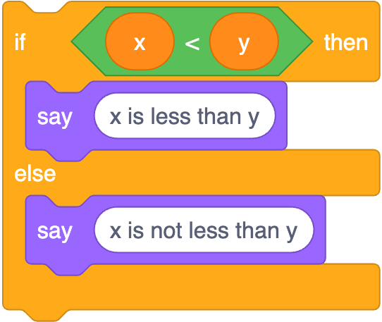
if (x < y) {
printf("x is less than y\n");
}
else
{ printf("x is not less than y\n");
}
Notes:
https://scratchblocks.github.io/#?style=scratch3&script=if%20%3C(x)%20%3C%20(y)%3E%20then%0Asay%20%5Bx%20is%20less%20than%20y%5D%0Aelse%0Asay%20%5Bx%20is%20not%20less%20than%20y%5D

Slide 81
if (x < y) {
printf("x is less than y\n");
}
else
{ printf("x is not less than y\n");
}

Slide 82
if (x < y) {
printf("x is less than y\n");
}
else
{ printf("x is not less than y\n");
}

Slide 83
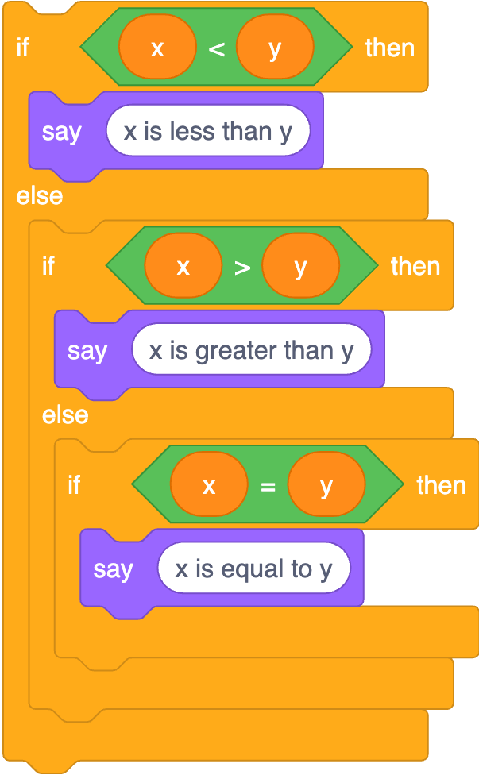
if (x < y) {
printf("x is less than y\n");
}
else if (x > y)
{ printf("x is greater than y\n");
}
else if (x == y)
{ printf("x is equal to y\n");
}
Notes:
https://scratchblocks.github.io/#?style=scratch3&script=if%20%3C(x)%20%3C%20(y)%3E%20then%0Asay%20%5Bx%20is%20less%20than%20y%5D%0Aelse%0Aif%20%3C(x)%20%3E%20(y)%3E%20then%0Asay%20%5Bx%20is%20greater%20than%20y%5D%0Aelse%0Aif%20%3C(x)%20%3D%20(y)%3E%20then%0Asay%20%5Bx%20is%20equal%20to%20y%5D

Slide 84
if (x < y) {
printf("x is less than y\n");
}
else if (x > y)
{ printf("x is greater than y\n");
}
else if (x == y)
{ printf("x is equal to y\n");
}

Slide 85
if (x < y) {
printf("x is less than y\n");
}
else if (x > y)
{ printf("x is greater than y\n");
}
else if (x == y)
{ printf("x is equal to y\n");
}

Slide 86
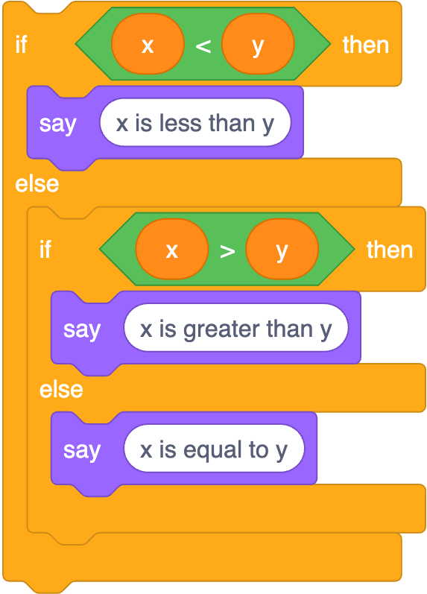
if (x < y) {
printf("x is less than y\n");
}
else if (x > y)
{ printf("x is greater than y\n");
}
else
{ printf("x is equal to y\n");
}
Notes:
https://scratchblocks.github.io/#?style=scratch3&script=if%20%3C(x)%20%3C%20(y)%3E%20then%0Asay%20%5Bx%20is%20less%20than%20y%5D%0Aelse%0Aif%20%3C(x)%20%3E%20(y)%3E%20then%0Asay%20%5Bx%20is%20greater%20than%20y%5D%0Aelse%0Asay%20%5Bx%20is%20equal%20to%20y%5D

Slide 87
operators

Slide 88
=
<
<=
>
>=
==
!=
…

Slide 89
types

Slide 90
bool
char
double
float
int
long
string
...

Slide 91
bool
char
double
float
int
long
string
...

Slide 92
cs50.h

Slide 93
get_char
get_double
get_float
get_int
get_long
get_string
...

Slide 94
get_char
get_double
get_float
get_int
get_long
get_string
...

Slide 95
format codes

Slide 96
%c
%f
%i
%li
%s

Slide 97
%c
%f
%i
%li
%s

Slide 98
variables

Slide 99
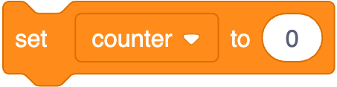
int counter = 0;
Notes:
https://scratchblocks.github.io/#?style=scratch3&script=set%20%5Bcounter%20v%5D%20to%20%5B0%5D

Slide 100
int counter = 0;

Slide 101
int counter = 0;

Slide 102
int counter = 0;

Slide 103

counter = counter + 1;
Notes:
https://scratchblocks.github.io/#?style=scratch3&script=change%20%5Bcounter%20v%5D%20by%20%5B1%5D

Slide 104
counter = counter + 1;;

Slide 105
counter += 1;

Slide 106
counter++;

Slide 107

counter--;
Notes:
https://scratchblocks.github.io/#?style=scratch3&script=change%20%5Bcounter%20v%5D%20by%20%5B-1%5D

Slide 108
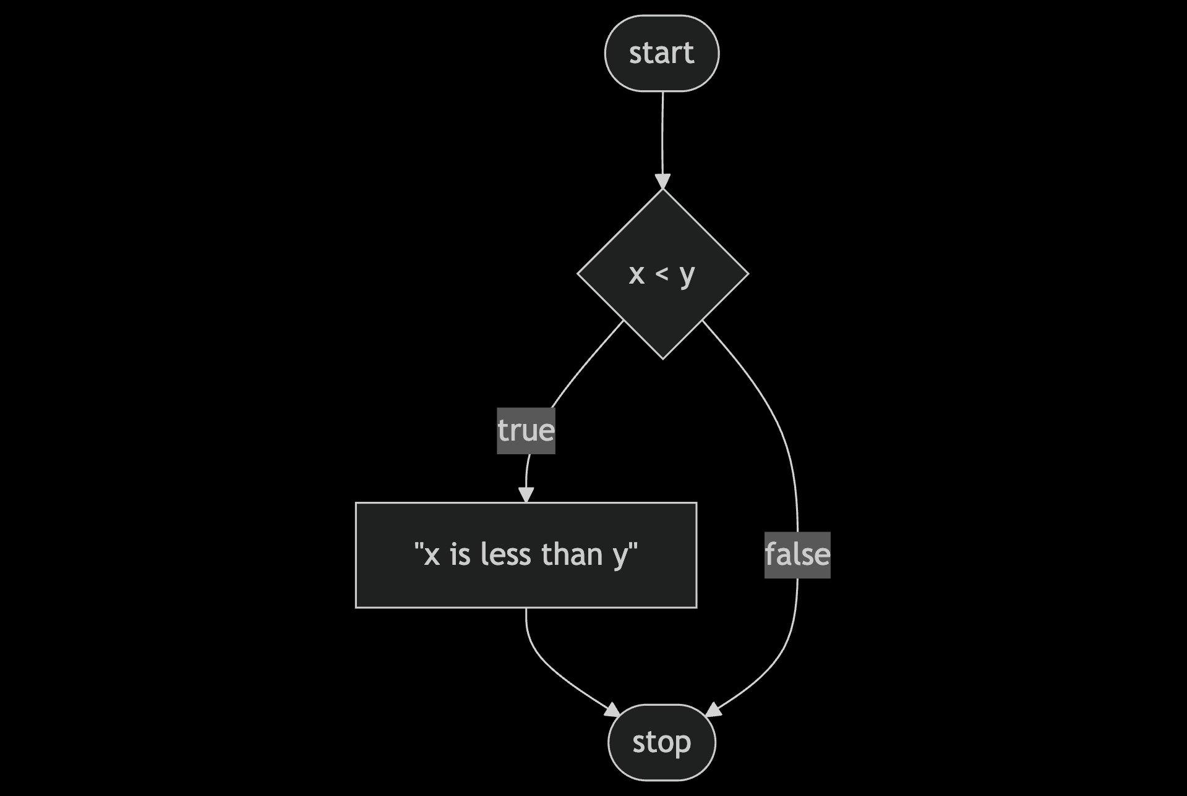
Notes:
compare0.c
https://mermaid.live/edit#pako:eNpNkMFugzAMhl_F8i5Dgheg06QBO-7UntZwsEg6UCGhidFAiHdfSMY0n-zvt39bXrExUmGOt958Ny1ZhkslNPh4e7469qBOIMteoVhneIFli2LhGbCdVNDKq8Cnx2T4NEPnoFfOAbekYYlUYB3HytBe7c5mrJN_XjfqXTT7XY8pDsoO1El_3bozgdyqQQnMfSrJ3gUKvfk-mticF91gvl-U4jRKYlV19GVpwDxYH_RddmzsH1Sh_Ig_CK9IcST9acwxuP0A4V5a9A

Slide 109
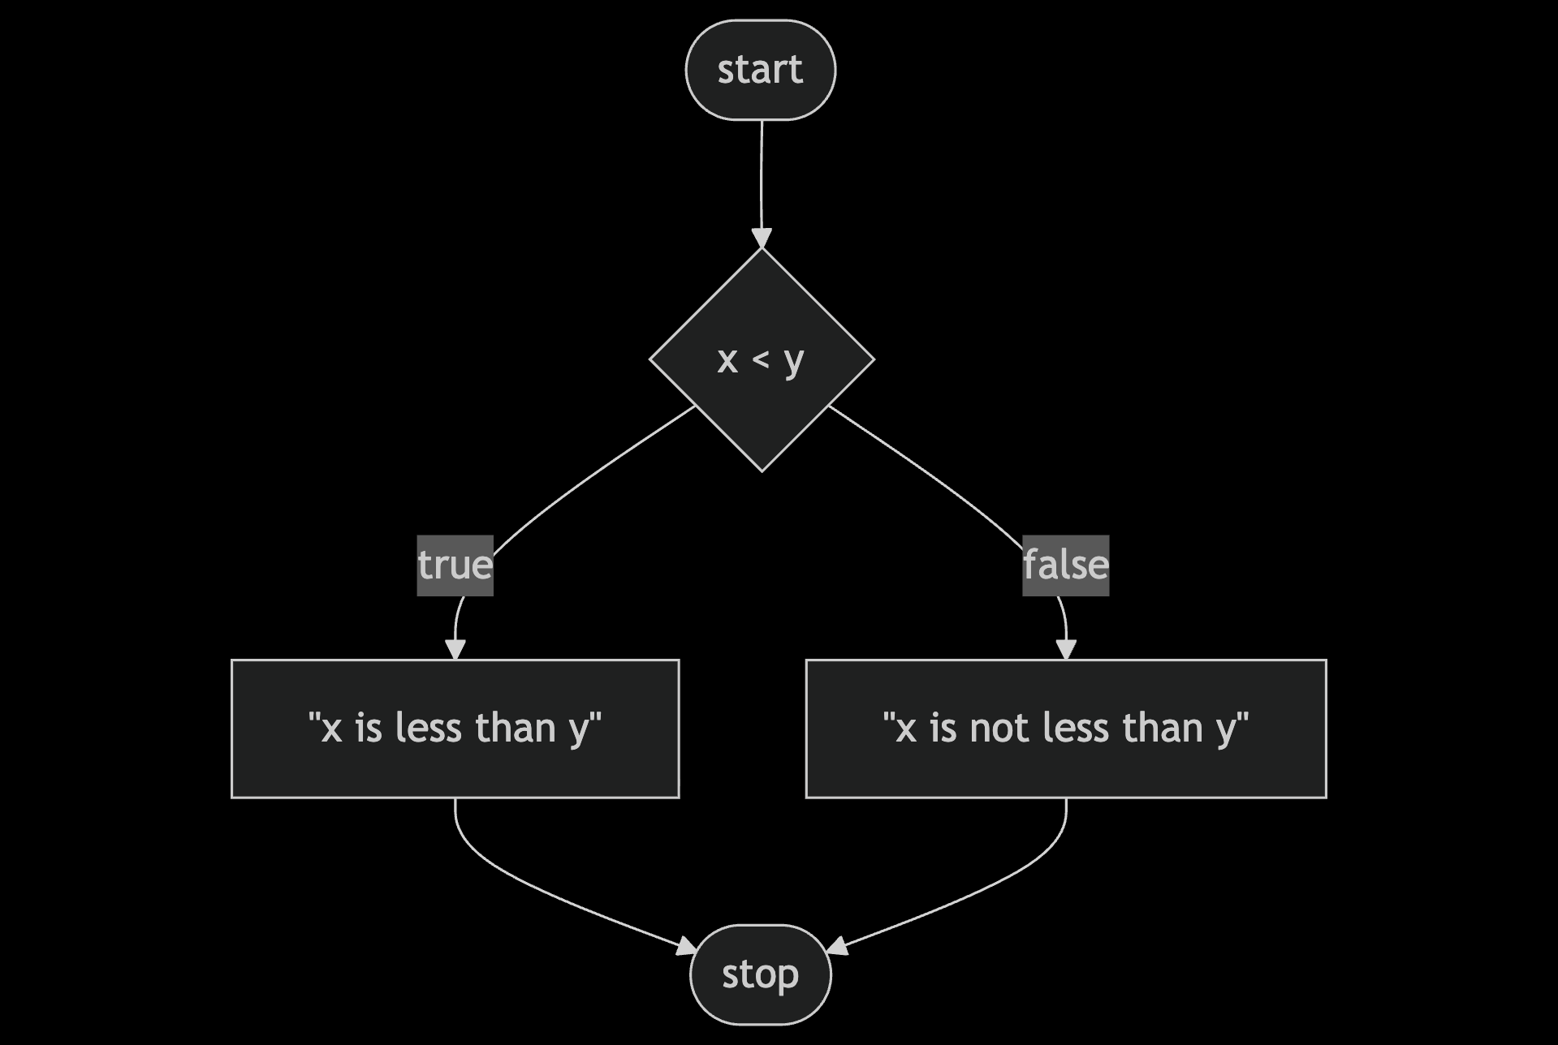
Notes:
compare1.c
https://mermaid.live/edit#pako:eNp9kMFugzAMhl_F8i6rRF-AVZXWwrGn7rSGg0XSgQoxS4xWhHj3hUSdtst8sv_f_mR7xpq1wRyvHX_VDTmBt0JZCPH6fPEShGoD2-0eDvMddjAtyTwEDcSNJnrHi8Knz5Hl5Q6th854D9KQhSmpCqs0doztxUrmodr8Yl2p8wlW_oVZln-AZQKuKWbYG9dTq8M582orlMb0RmEeUk3uplDZJfTRKHyebI35ekKG46BJTNHSh6Me87jLQy11K-x-RBPLU3pa_F2GA9l35sfg8g0ckGn4

Slide 110
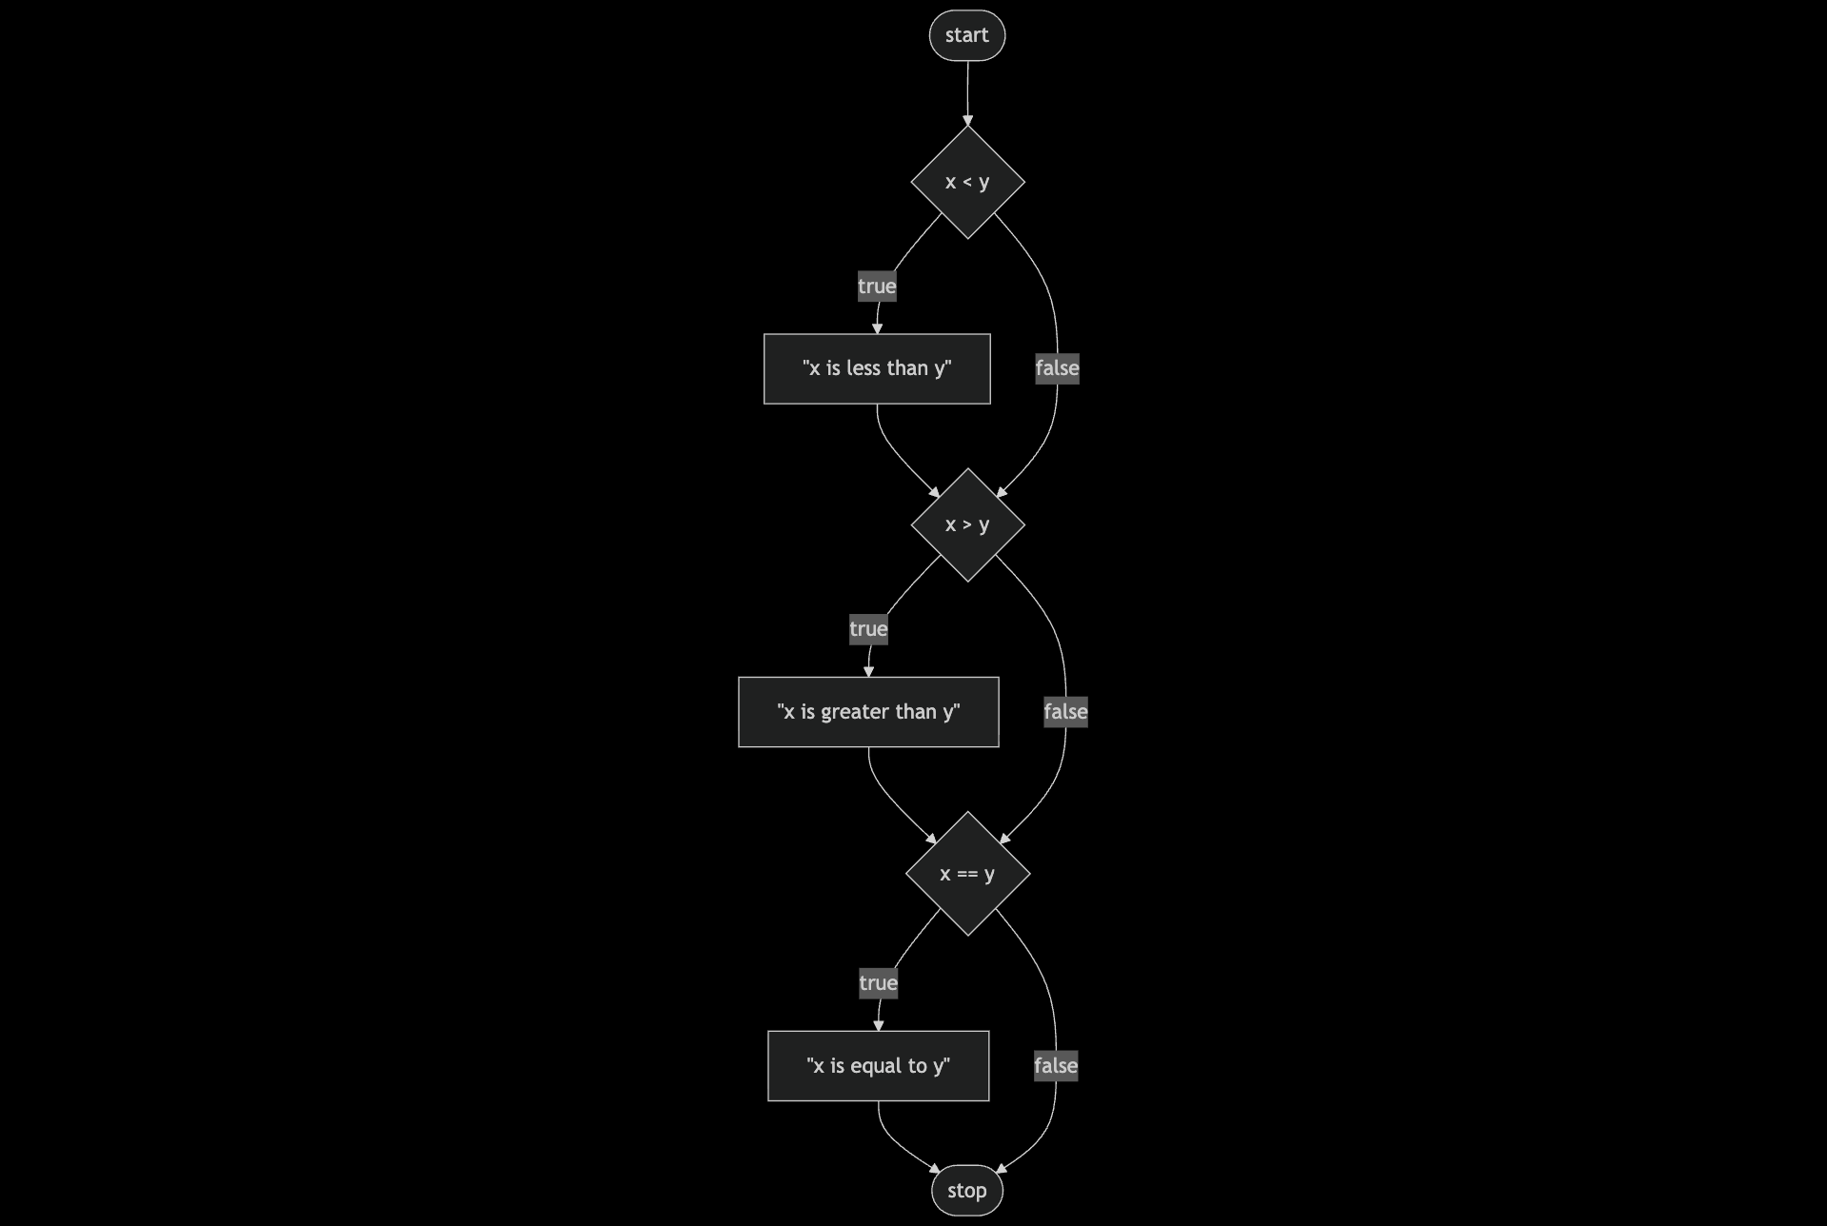
Notes:
compare2.c - ZOOM IN
https://mermaid.live/edit#pako:eNptkcFugzAMhl_F8i6rRF-ArZXWBtrLTttpDQeLpAUNCE2CVoR494WgUtCWU_L792c77jBVQmKI50L9pBlpC5-MV-DO2_PJWCckK1ivt7DrbvAKbT8Gd04DqxvpY_sTx6dro-zLDXIDhTQGbEYVtKPKMRnT9t7OHGo7odgCFS1RFy3JSv0_LfIZsaNtNhMuXuAOS5y8NlSAVX9QB-8-DiOrOlnNhjxTYUYWm_X7UONZ2Yd6xABLqUvKhfvcbvBwtJksJcfQXQXpb4686p2PGqs-2irFcGg7wKYWbmaW00VTiaGH3tVI5FbpSZT--T6u0G8ywJqqL6Xuif0vYHGQ9A

Slide 111
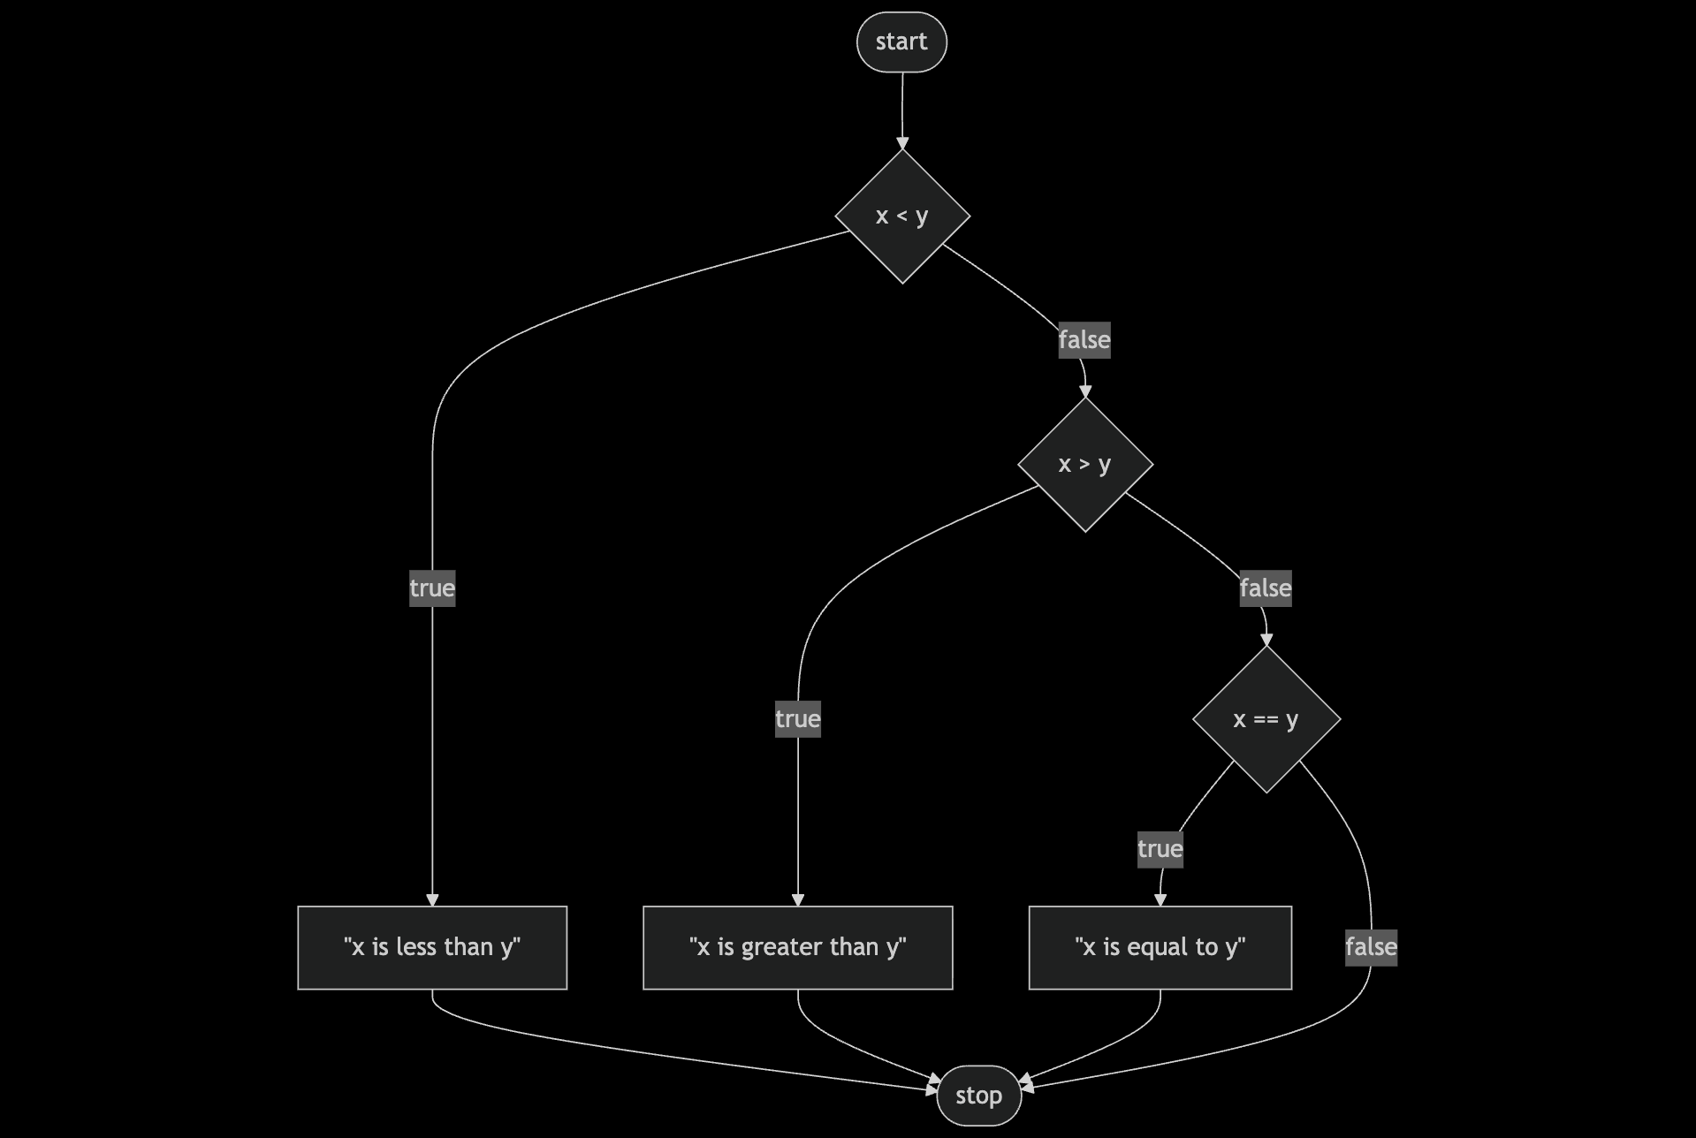
Notes:
compare3.c
https://mermaid.live/edit#pako:eNptkc9ugzAMxl_F8i6rRF-ArZXWhraXnbbTGg4WSQsqEJo_WhHi3RdAMNCWU77P9s-J3WCihMQQL7n6TlLSFj4ZL8Gft-ezsd6IV7Beb2HXPOAV6nYI7rwHVjvZx_Znjk93p-zLAzIDuTQGbEol1IPLMZ6VXSg3Qx3zzO3EZAtmtGRetSQr9f9YtsQePHazmbiHBfe45Mq7oxys-sM89tmnbgiqilcz1G-j0-Du5yIaBQZYSF1QJvx4my7I0aaykBxDfxWkbxx52fo8clZ91GWCYffMAF0l_GdZRldNBYZ9w9GNRGaVnkzZy_dhif0uA6yo_FJqLGx_AMcUkcQ

Slide 112
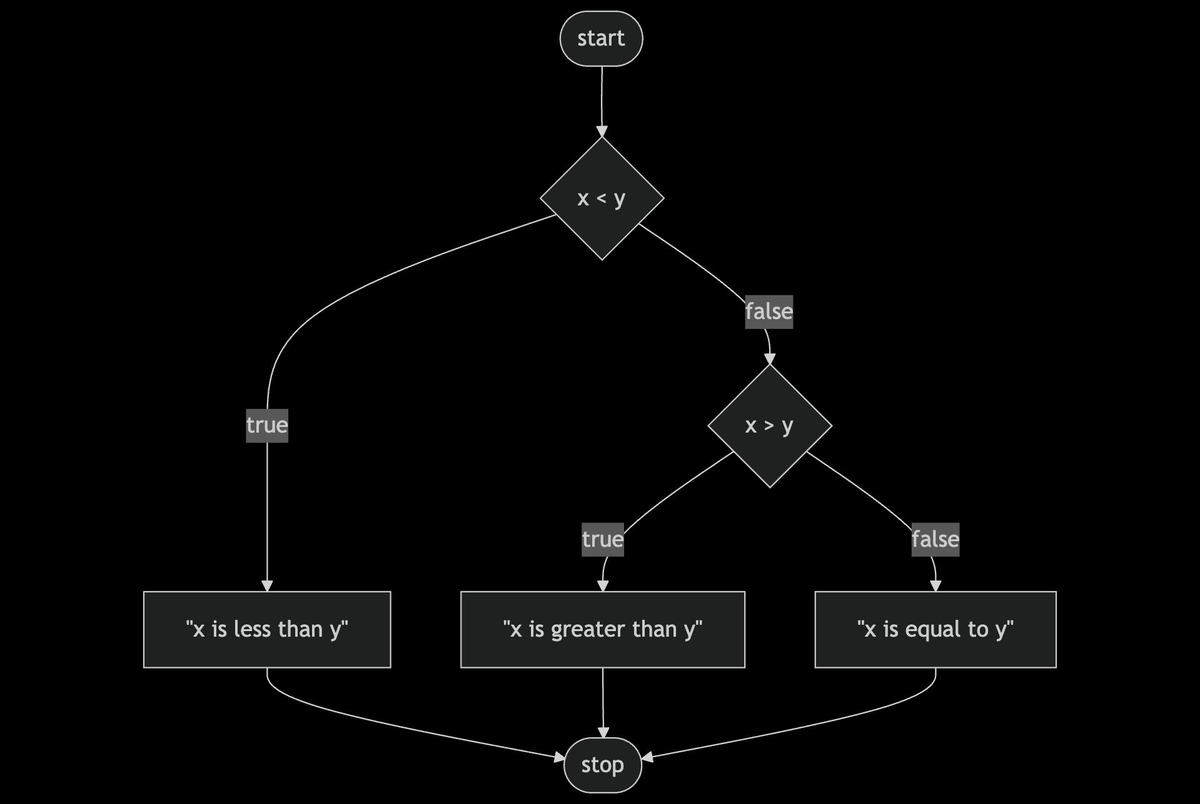
Notes:
compare4.c
https://mermaid.live/edit#pako:eNptkctOwzAQRX9lNGyolP5AQJVonYoNK1hRZzGK3SYisVM_RKMo_45jKxUReOU5M_dqHiNWWkjM8dzq76om4-CDcQXhvTyerAug3MB2u4P9eINnGKaU3AcGzngZc4cTx4er1-7pBo2FVloLriYFQ6Icy1-yM7U26Vjw3N092cqzWHtejCQnzf-2bG17XEvl1VMLTv-RHWP16zyn7stNgocEU1AsAWbYSdNRI8KuxjnJ0dWykxzz8BVkvjhyNYU68k6_D6rCfJ4lQ9-L0Dlr6GKowzy2udBCNE6bO5QxfEsXiYfJsCf1qfUinH4AYdKEwg

Slide 113
bool
char
double
float
int
long
string
...

Slide 114
get_char
get_double
get_float
get_int
get_long
get_string
...
Notes:
agree{0,1,2}.c

Slide 115
loops
Notes:
cat0.c

Slide 116
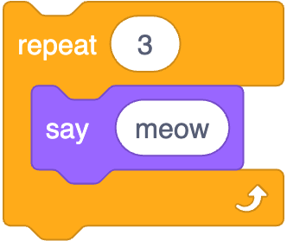
Notes:
https://scratchblocks.github.io/#?style=scratch3&script=repeat%20%5B3%5D%0Asay%5Bmeow%5D

Slide 117
int i = 3;
while (i > 0)
{
printf("meow\n");
i--;
}
Notes:
cat1.c, but use counter first

Slide 118
int i = 3;
while (i > 0)
{
printf("meow\n");
i--;
}
Notes:
cat1.c, but use counter first

Slide 119
int i = 0;
while (i < 3)
{
printf("meow\n");
i++;
}
Notes:
cat{2,3}.c

Slide 120
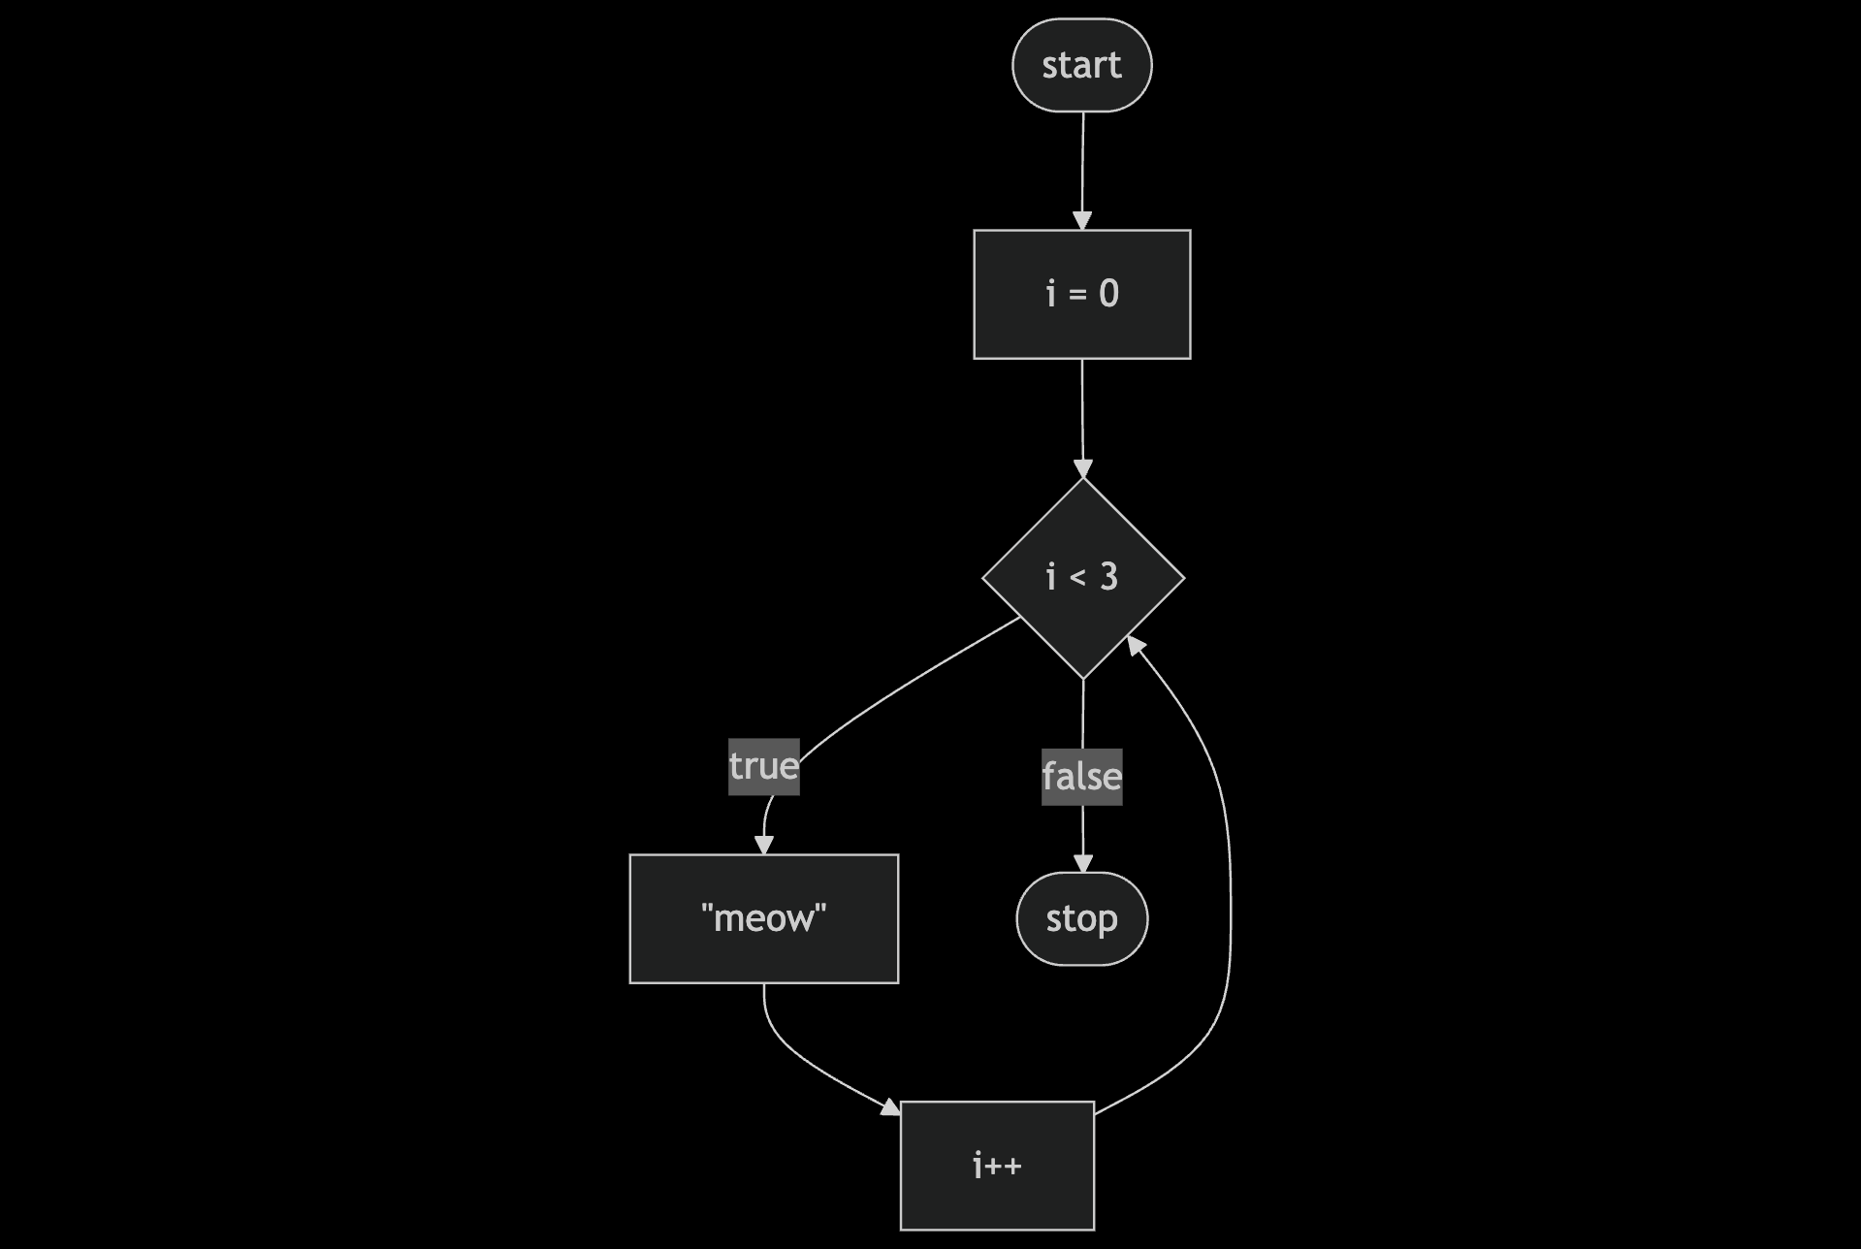
Notes:
https://mermaid.live/edit#pako:eNpNkEFvwjAMhf-KZS4gioS0WzeQgHa3ncaJpgerSUc0EnchFZqq_velCUz4ZH9-fnrygA1LhTm2F741Z3IejoWwEGo3r64-gHoBq9UW9pWGDazrtNxHdhg0vMHLmNghMPCuV3FXVAJnPz37V6P4ljqB9_MiSspKL5d3UibDJ6eWLtdk9T4l4a5eCIsZGuUMaRkyD5NaoD8rowTmoZXkvgUKOwYd9Z4_f22D-ZQpw76T5FWh6cuRwTzaP2gptWf3D1UcP9Jn4oMy7MiemB-H4x_2fV7F

Slide 121
for (int i = 0; i < 3; i++)
{
printf("meow\n");
}
Notes:
cat4.c

Slide 122

Notes:
https://mermaid.live/edit#pako:eNpNkEFvwjAMhf-KZS4gioS0WzeQgHa3ncaJpgerSUc0EnchFZqq_velCUz4ZH9-fnrygA1LhTm2F741Z3IejoWwEGo3r64-gHoBq9UW9pWGDazrtNxHdhg0vMHLmNghMPCuV3FXVAJnPz37V6P4ljqB9_MiSspKL5d3UibDJ6eWLtdk9T4l4a5eCIsZGuUMaRkyD5NaoD8rowTmoZXkvgUKOwYd9Z4_f22D-ZQpw76T5FWh6cuRwTzaP2gptWf3D1UcP9Jn4oMy7MiemB-H4x_2fV7F

Slide 123
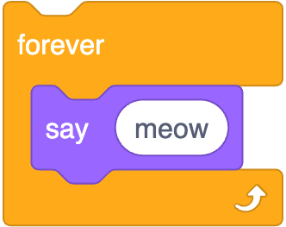
while (true)
{
printf("meow\n");
}
Notes:
https://scratchblocks.github.io/#?style=scratch3&script=forever%0Asay%5Bmeow%5D

Slide 124
while ( )
{
}

Slide 125
while (true)
{
}

Slide 126
while (true)
{
printf("meow\n");
}
Notes:
cat5.c

Slide 127
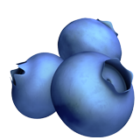
Notes:
https://emojipedia.org/cookie/

Slide 128
If you'd like a stress ball, what do today's binary bulbs spell?
Notes:
https://emojipedia.org/cookie/

Slide 129
control-c
Notes:
cat{6,7,8,9,10}.c

Slide 130
scope
Notes:
cat{6,7,8,9,10}.c

Slide 131
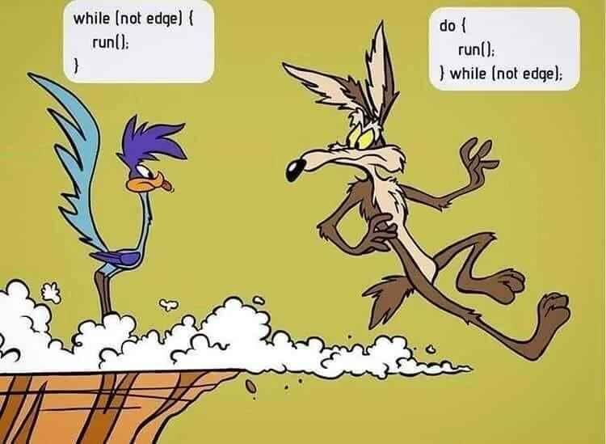
Notes:
Source: unknown

Slide 132
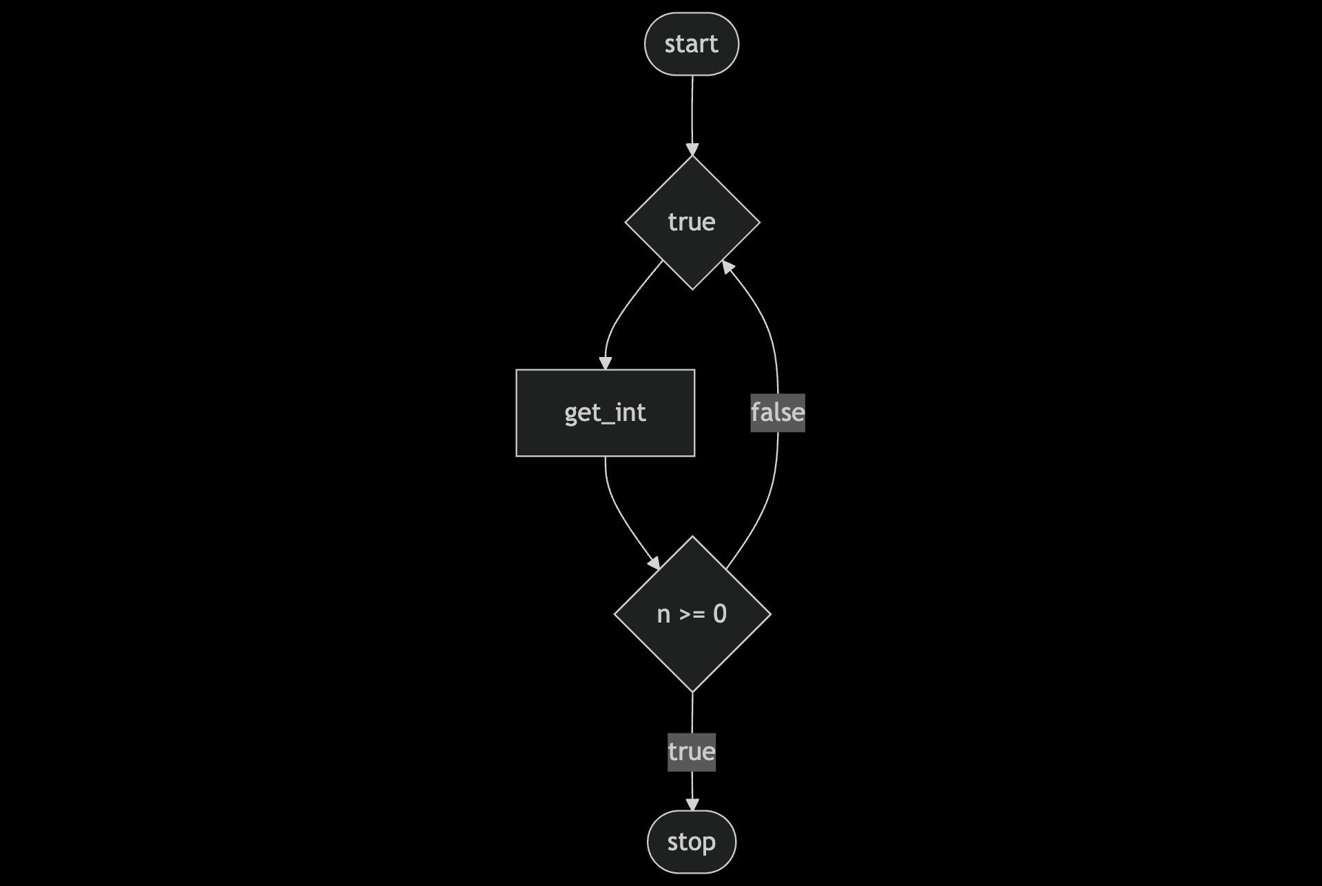
Notes:
https://mermaid.live/edit#pako:eNpNkE1vgyAYx78KeU5rYg1SUUuyJlN73Gk7rTYLUXxJFAzFbJ3xu0-xbcoJfv8XHhghV4UABmWrfvKaa4M-00yieb29nC5mBucN2m4PKB6NHsS0arFFyakS5ruR5rzSxNJ0lOjwivDNms4QLVErHpdS1Z83T2LJ28uqxuBAJ3THm2IeaVw8GZhadCIDNm8LUfKhNRlkcpqtfDDq4ypzYEu_A0NfcCPShlead8Bs750ei8Yo_YDCHt_Xt9svcKDn8kup7t6m1VDVj0Cll5luipCF0IkapAFG9sRGgY3wC2znhS6mkbcPgx2hHvYduAILqOtFfhARn5IwosSfHPizd2E3jDwSYEoxJsQjlEz_0vl4eg

Slide 133
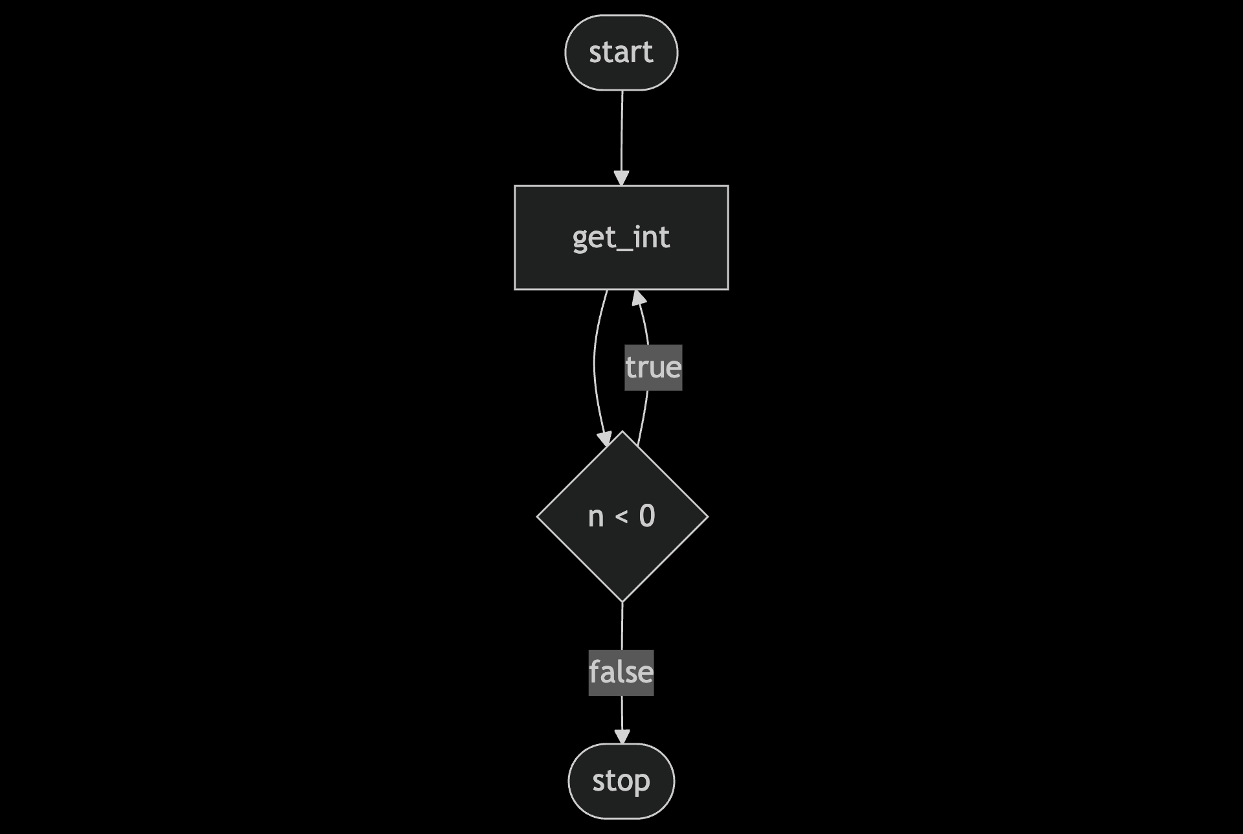
Notes:
https://mermaid.live/edit#pako:eNpNj8FugzAMhl8l8mmVKEpSAlk0TVphx5220wqaIkgBrSQoDdo6xLsPwlrNJ_uz_9_2CKWpFAg4nsxX2Ujr0FuWazTH093h7GZQbNB2-4j2h1q5j1a7Ym3vPU1HjR4QnlaWzgw5O6hV8Q8e5em80myxNX2xgQA6ZTvZVvP6cZnNwTWqUzmIOa2k_cwh19M8JwdnXi-6BLGYBzD0lXQqa2VtZQfCm1_pc9U6Y29Q-fJlfdL_GkAv9bsx3dXNmqFuboLaLgf9dZSulE3NoB0IwriXghjhG8SOJCFmnNwn8Y4ygqMALiBiFhIexZxGjCac0WgK4MfvwmHCCY0xYxhTSiij0y9Ma3GV

Slide 134
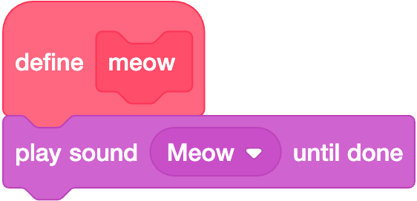

Slide 135
void meow(void)
{
printf("meow\n");
}

Slide 136
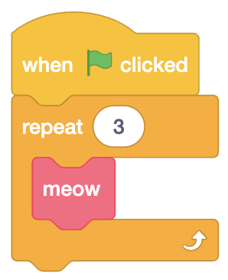

Slide 137
int main(void)
{
for (int i = 0; i < 3; i++)
{
meow();
}
}
Notes:
cat11.c

Slide 138
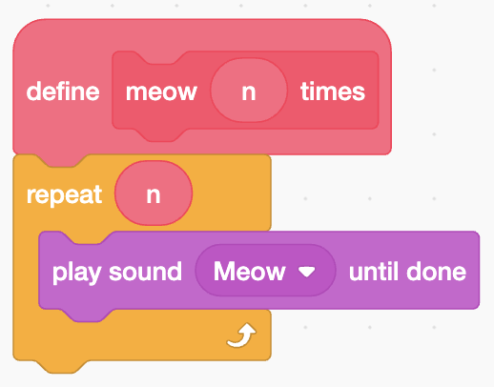

Slide 139
void meow(int n)
{
for (int i = 0; i < n; i++)
{
printf("meow\n");
}
}

Slide 140
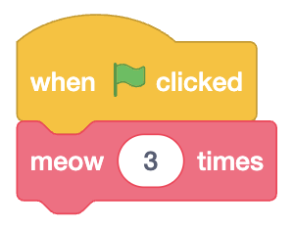

Slide 141
int main(void)
{
meow(3);
}
Notes:
cat12.c

Slide 142
comments

Slide 143
scope
Notes:
cat{13,14,15}.c

Slide 144
correctness, design, style

Slide 145
check50, design50, style50

Slide 146
function
arguments →
→ side effects

Slide 147
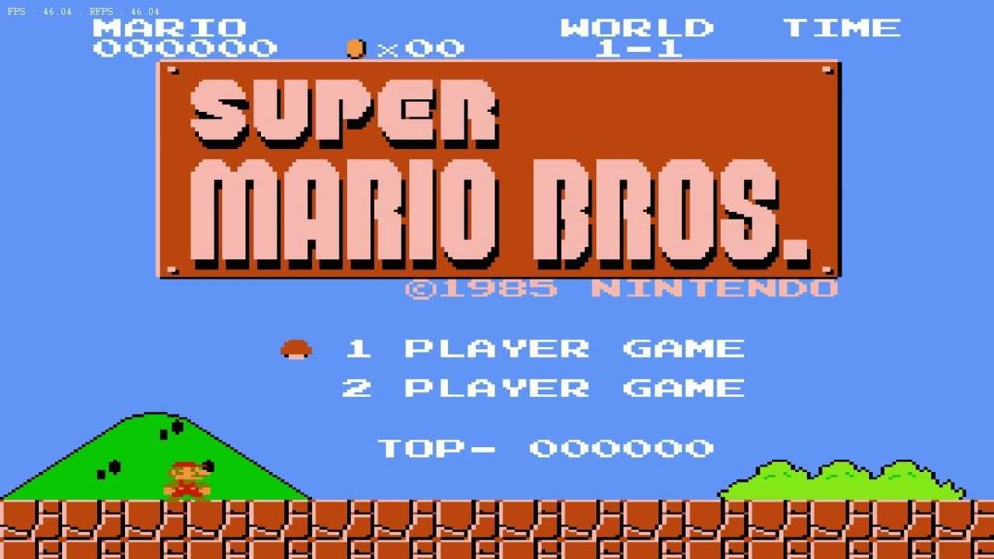

Slide 148
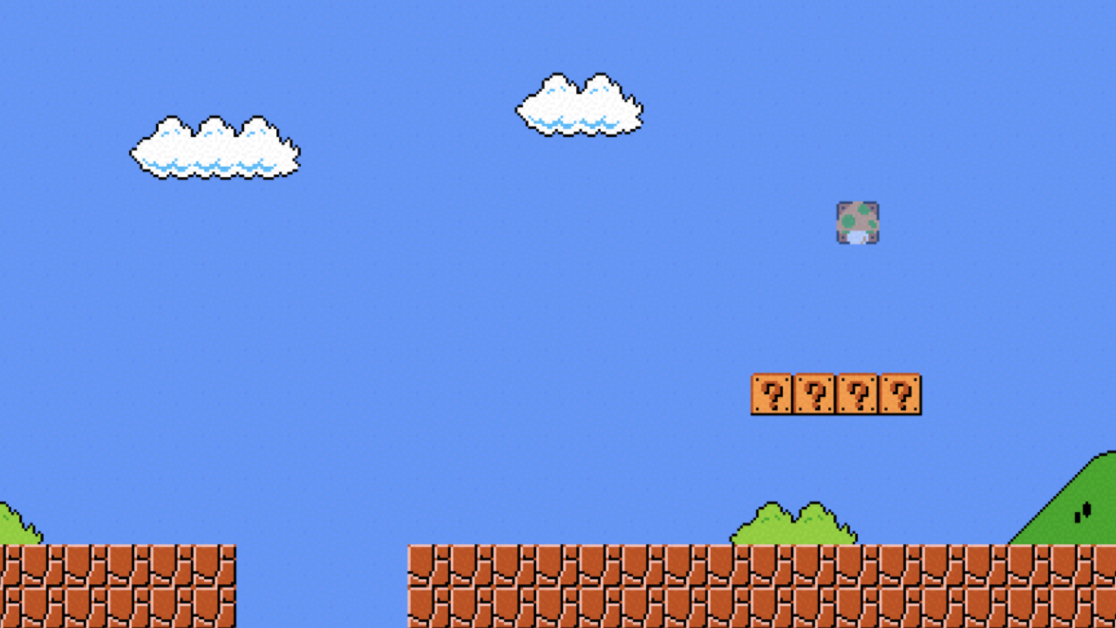

Slide 149
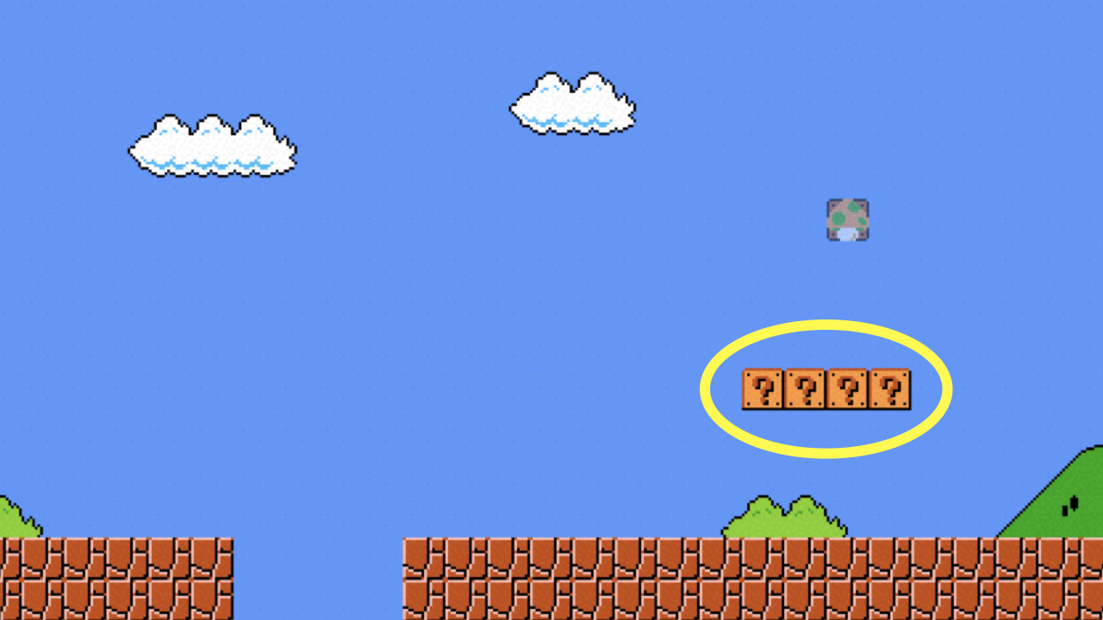
Notes:
mario{0,1}.c

Slide 150
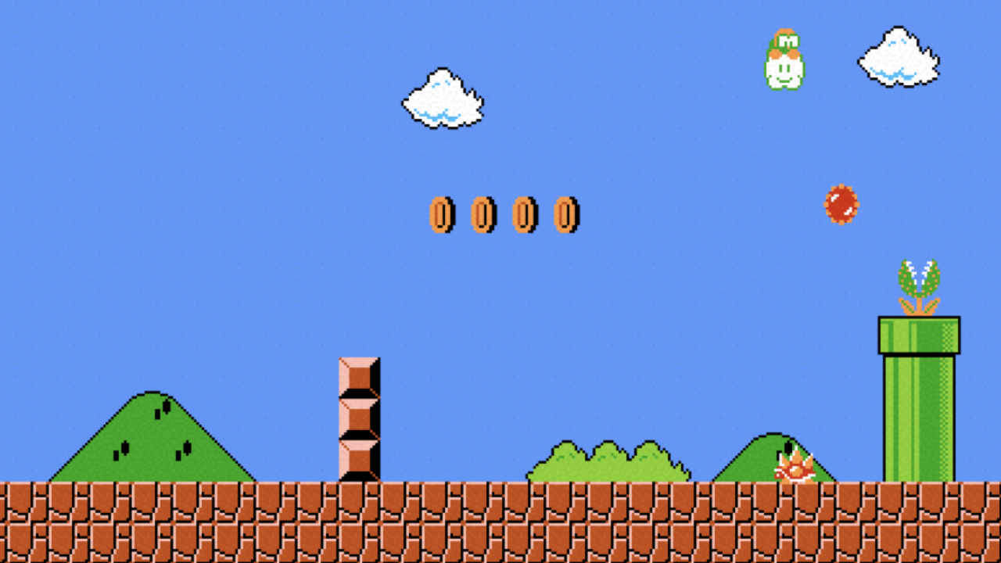

Slide 151
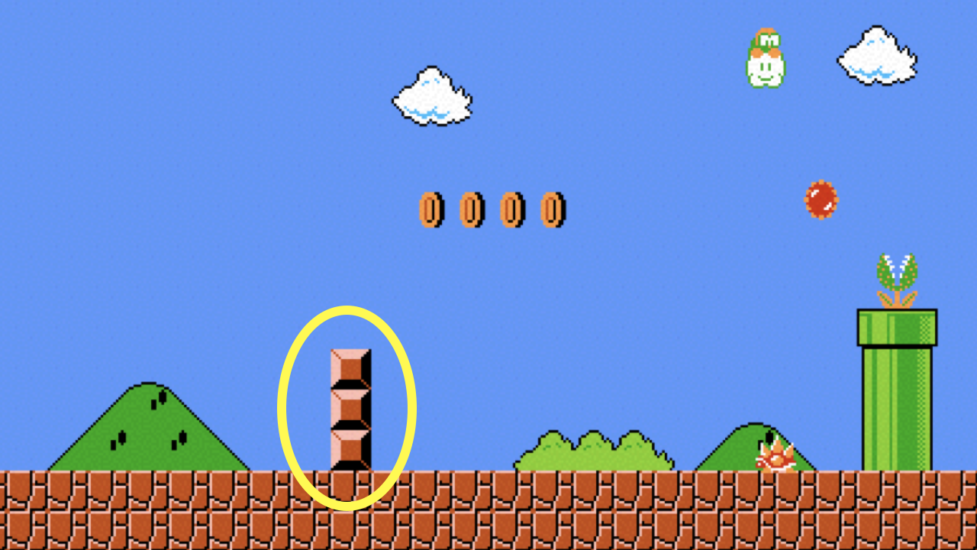
Notes:
mario2.c

Slide 152
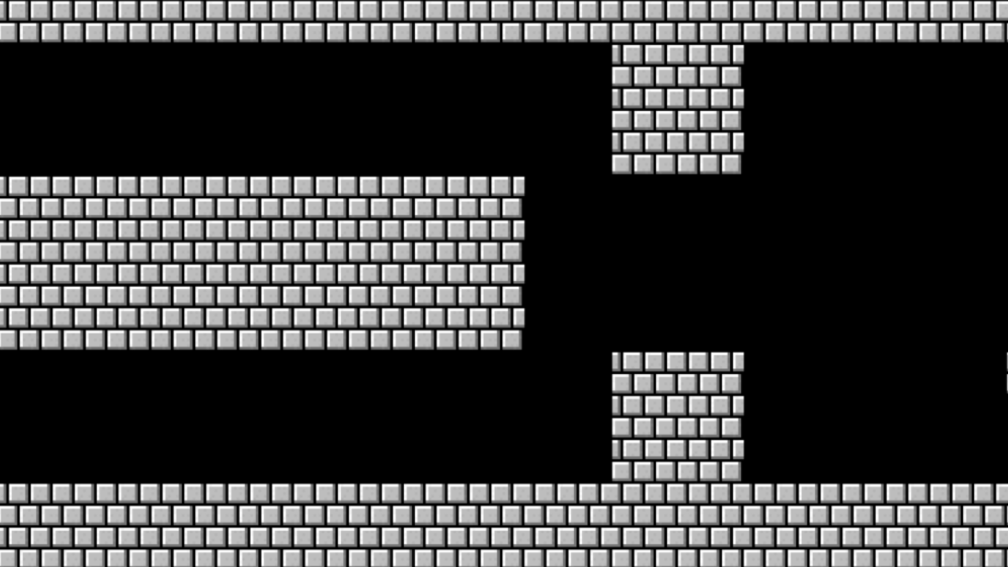

Slide 153
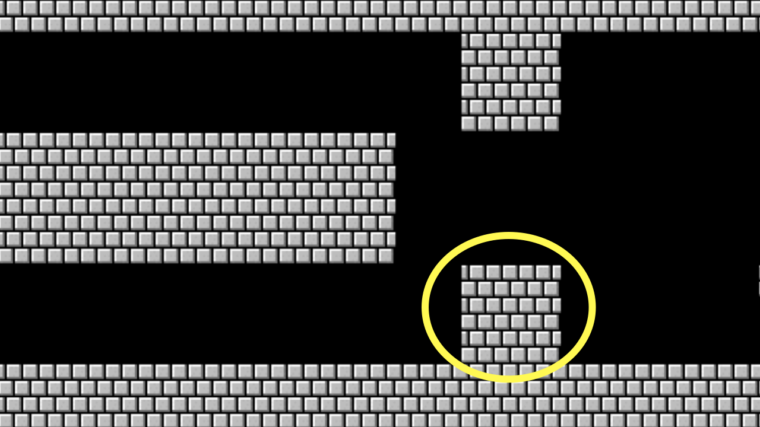
Notes:
mario3.c

Slide 154
constants
Notes:
mario{4,5}.c

Slide 155
function
arguments →
→ return value

Slide 156
+
-
*
/
%
…
Notes:
calculator{0,1,2}.c

Slide 157
integer overflow

Slide 158
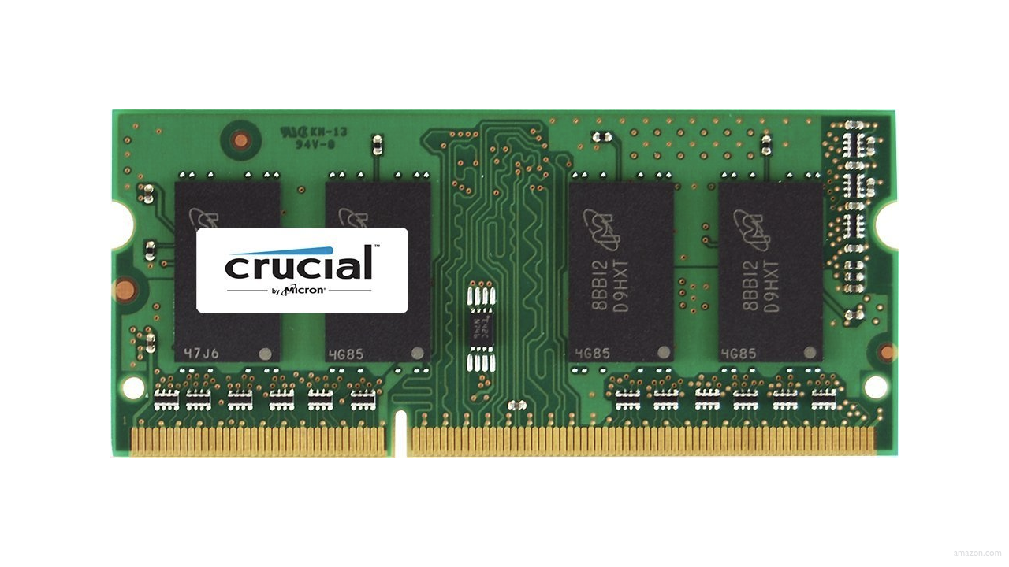

Slide 159
0000

Slide 160
0001

Slide 161
0010

Slide 162
0011

Slide 163
0100

Slide 164
0101

Slide 165
0110

Slide 166
0111

Slide 167
1000

Slide 168
1000
Notes:
calculator{3,4}.c

Slide 169
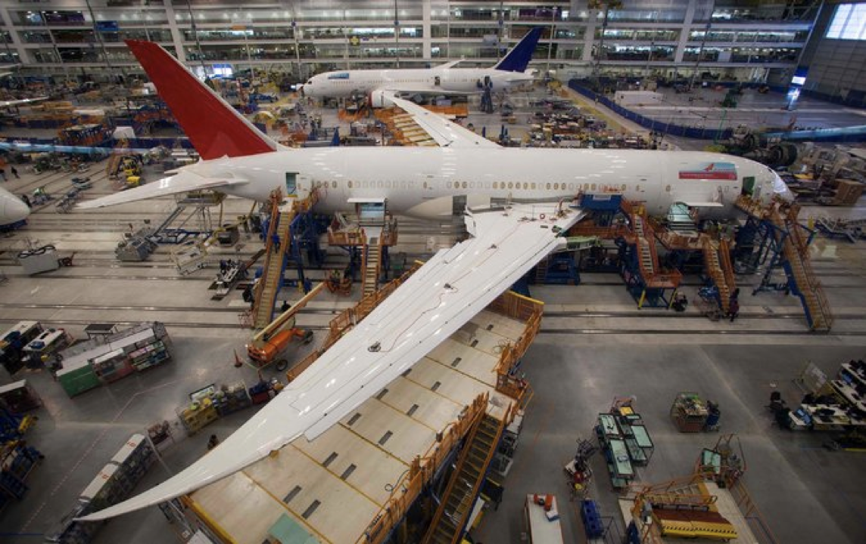
Notes:
Boeing 787
"a Model 787 airplane that has been powered continuously for 248 days can lose all alternating current (AC) electrical power due to the generator control units (GCUs) simultaneously going into failsafe mode," the memo stated. "This condition is caused by a software counter internal to the GCUs that will overflow after 248 days of continuous power... Boeing is in the process of developing a GCU software upgrade that will remedy the unsafe condition." - http://arstechnica.com/information-technology/2015/05/boeing-787-dreamliners-contain-a-potentially-catastrophic-software-bug/
A simple guess suggests the the problem is a signed 32-bit overflow as 2^31 is the number of seconds in 248 days multiplied by 100, i.e. a counter in hundredths of of a second.
https://www.i-programmer.info/news/149-security/8548-reboot-your-dreamliner-every-248-days-to-avoid-integer-overflow.html

Slide 170
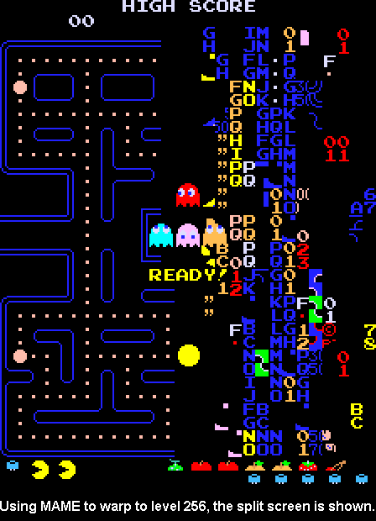
Notes:
https://pacman.fandom.com/wiki/Map_256_Glitch
"The level counter in the original Pac-Man is stored as an 8-bit integer, meaning the highest value it can hold is 255. The level counter starts with 0 internally, but for calculating the fruit counter it adds 1; however, because of overflow, adding 1 to 255 would result in 0, and the game tries to count fruits from 1, causing the game to attempt to draw 256 fruit to the screen until it overflows to 0. The result is the garbled mess on the right side of the maze, because the screen memory starts with the bottom, followed by the columns from the right side."

Slide 171
truncation
Notes:
calculator{5,6}.c
1/3, 2/3, 3/3, 4/3

Slide 172
floating-point imprecision
Notes:
calculator{7}.c
1/3

Slide 173
Year 2000 Problem

Slide 174
1999

Slide 175
1999

Slide 176
1900

Slide 177
Year 2038 Problem

Slide 178
19 January 2038

Slide 179
13 December 1901

Slide 180
19 January 2038
Notes:
https://time.cs50.io/20380119T031407+0000

Slide 181


